Slide 1
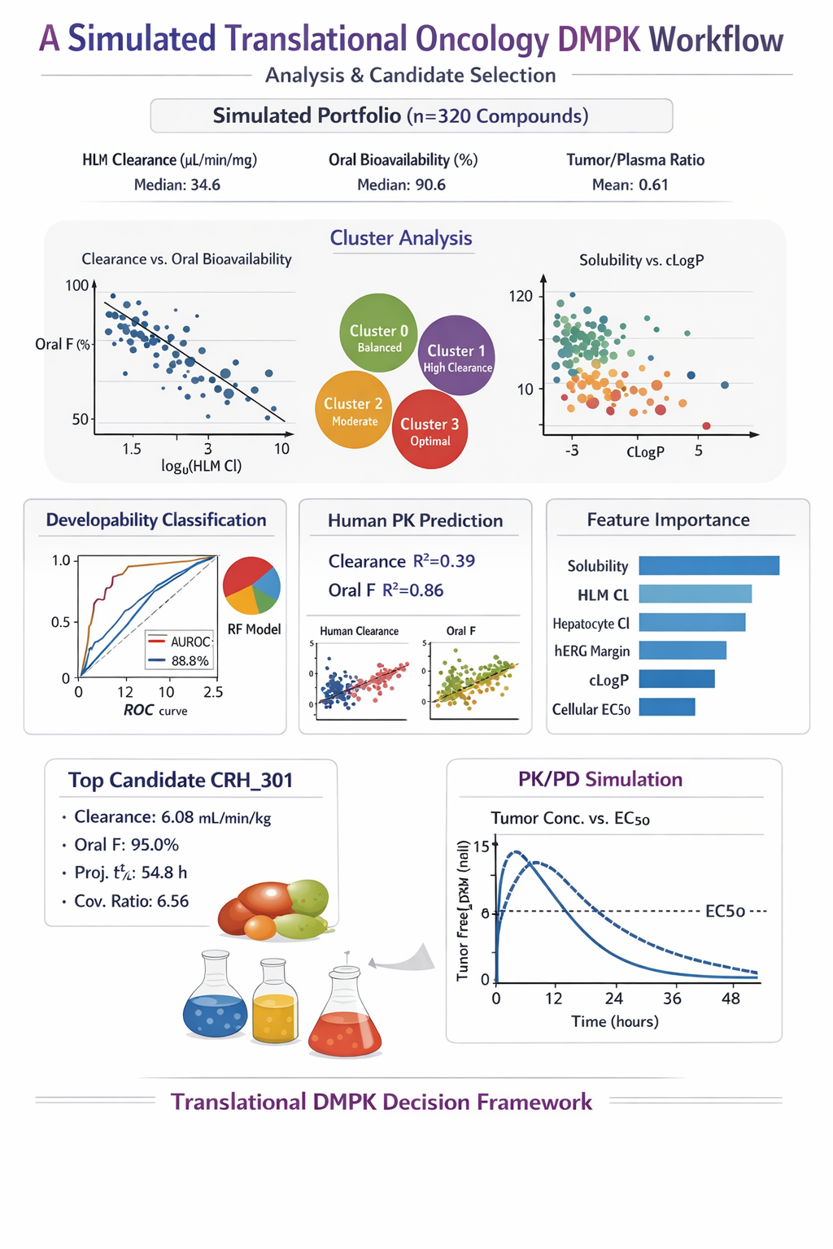
Translational Oncology
DMPK Workflow
A literature-benchmarked simulation of 320 compounds integrating exploratory DMPK analysis, machine learning, candidate ranking, and simplified PK/PD translation.
320
4
CRH_301
portfolio size
clusters
top candidate
Focus for the interview: how I structure translational evidence, quantify trade-offs, and turn noisy DMPK data into program decisions.
Notes:
[Sources] - User-provided generated infographic asset: /mnt/data/an_infographic_summarises_the_simulated_translatio.png - User-provided executed notebook with underlying analysis and figures: /mnt/data/principal_scientist_dmpk_oncology_proof_of_concept_executed-2.ipynb

Slide 2
What the workflow was built to show
DMPK decision process from assay-style data to translational prioritisation
01
02
03
04
Simulate
Explore
Model
Decide
Physchem, ADME, safety, potency, tumor distribution, and projected human PK.
Identify exposure, clearance, solubility, and coverage relationships.
Use clustering, classification, regression, and feature importance.
Rank candidates, challenge the lead, and examine a PK/PD scenario.
Benchmarked variable families
Why this matters
Design anchors from the executed notebook
• Physicochemical space: MW, cLogP, TPSA, pKa, H-bond counts
• ADME: solubility, fu, HLM CLint, hepatocyte CLint, Caco-2 Papp, efflux
• Safety proxies: CYP3A4, CYP2D6, hERG
• Translational outputs: oral F, human CL, half-life, dose, coverage ratio
Potency is filtered through exposure, free drug, tumor distribution, safety margin, and clinically plausible dosing before a compound can be considered truly attractive.
431
34.6
90.6%
mean MW
median HLM CL
median oral F
0.61
54.8 h
74.9 mg
mean T/P
top t½
top dose
Notes:
[Sources] - User-provided executed notebook: /mnt/data/principal_scientist_dmpk_oncology_proof_of_concept_executed-2.ipynb - Background rationale reflected in the notebook manuscript: Sachs et al., Clinical Cancer Research 2016, PMID 26597302; Saeheng et al., European Journal of Clinical Pharmacology 2018, PMID 29978293.

Slide 3
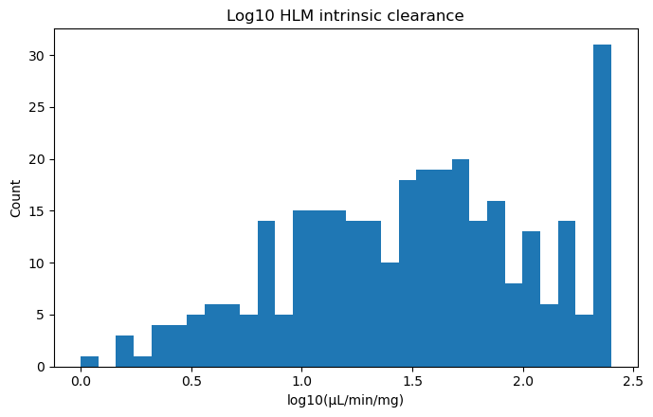
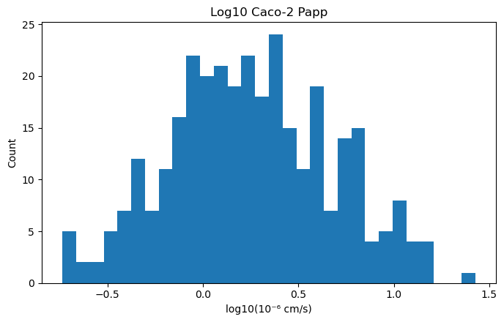
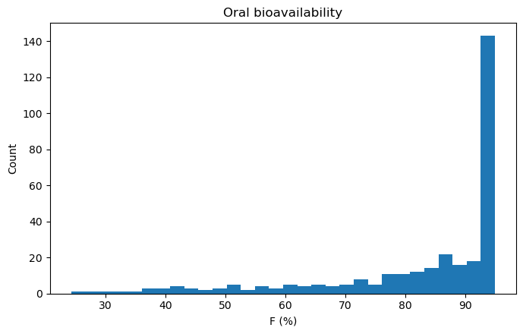
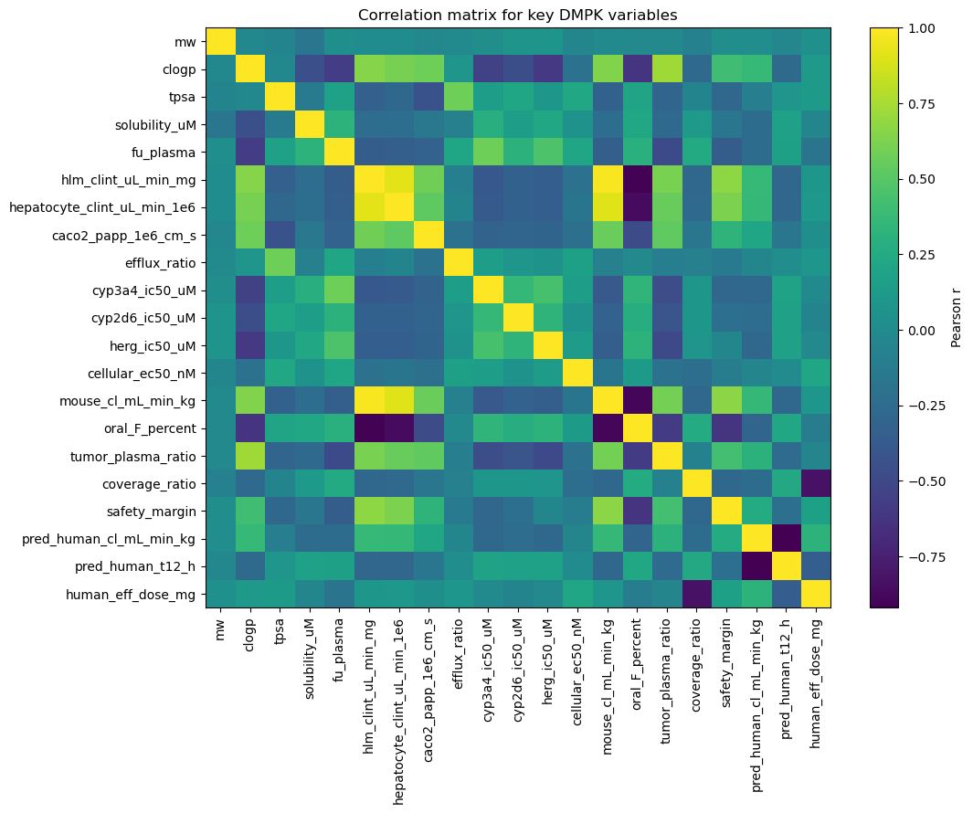
Exploratory findings: the translational tensions are visible immediately
Three early relationships already explain much of the downstream developability behavior.
Key interpretation
1. Higher HLM intrinsic clearance eroded oral exposure across the portfolio.
2. Higher cLogP improved permeability but penalised solubility, creating a classic developability trade-off.
3. Tumor:plasma ratio alone did not guarantee target coverage; potency, fu, and exposure duration still mattered.
4. The correlation map shows why candidate selection cannot rely on a single metric.
Notes:
[Sources] - All claims and visual assets on this slide are derived from the user-provided executed notebook: /mnt/data/principal_scientist_dmpk_oncology_proof_of_concept_executed-2.ipynb - Derived plot assets: cell6_out0.png, cell6_out1.png, cell6_out3.png, cell8_out0.png extracted from notebook outputs.

Slide 4
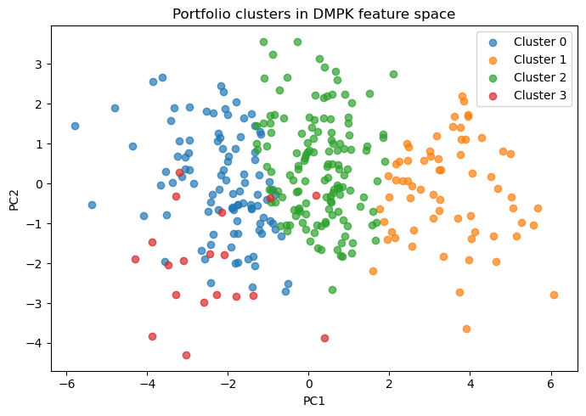
Portfolio structure: four translational archetypes
Clustering converts a flat dataset into a map of decision-relevant compound behaviors.
Cluster read-out
Cluster 0 | exposure-rich but weak coverage
Median oral F 95%. HLM CL 10.6 µL/min/mg. Coverage ratio only 0.52, so exposure alone did not translate into robust efficacy.
Cluster 1 | fast-clearance liabilities
Median oral F 55.8%. HLM CL 176.5 µL/min/mg. Coverage ratio 0.05, representing chemotypes unlikely to progress without redesign.
Cluster 2 | middle-of-the-portfolio
Median oral F 89.6%. HLM CL 40.9 µL/min/mg. A workable but unremarkable region needing stronger translational differentiation.
Cluster 3 | translational sweet spot
Median oral F 95%. HLM CL 14.0 µL/min/mg. Coverage ratio 3.53 and lower projected dose; this is where the best candidates concentrated.
Notes:
[Sources] - User-provided executed notebook: /mnt/data/principal_scientist_dmpk_oncology_proof_of_concept_executed-2.ipynb - Derived PCA cluster plot asset: cell10_out0.png extracted from notebook outputs - Cluster medians reproduced from notebook cluster_profile output.

Slide 5
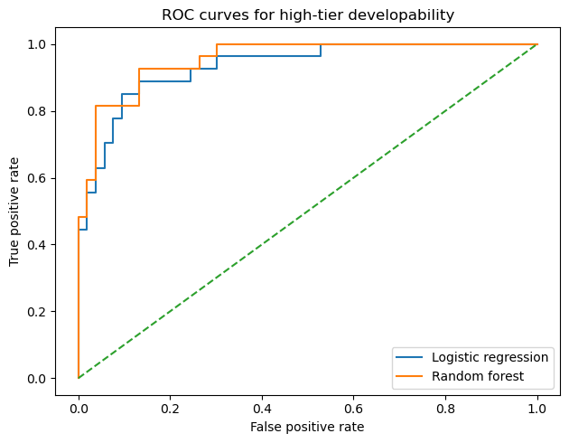
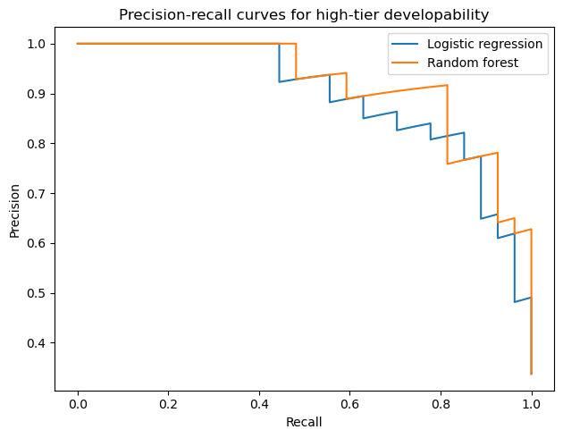
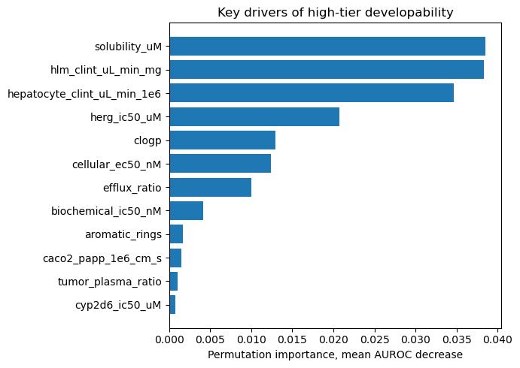
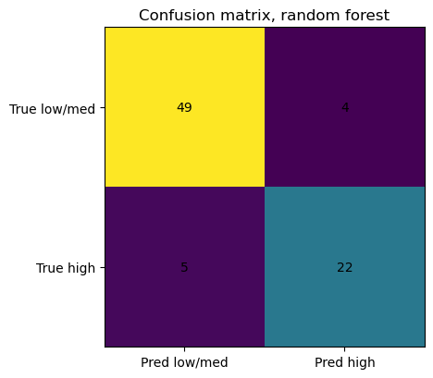
Machine learning for high-tier developability
The classifier was useful because its signal aligned with mechanistic DMPK intuition.
Random forest performance
0.954
0.920
AUROC
AUPRC
0.888
0.830
Accuracy
F1
Top drivers were solubility, HLM CL, hepatocyte CL, hERG margin, cLogP, and cellular potency.
Notes:
[Sources] - User-provided executed notebook: /mnt/data/principal_scientist_dmpk_oncology_proof_of_concept_executed-2.ipynb - Derived plot assets: cell13_out0.png, cell13_out1.png, cell13_out2.png, cell16_out0.png extracted from notebook outputs - Metrics reproduced from notebook classification results and permutation-importance output.

Slide 6
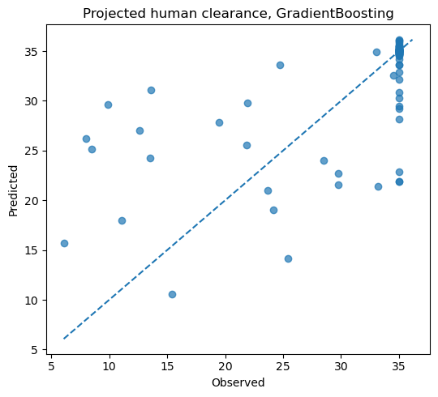
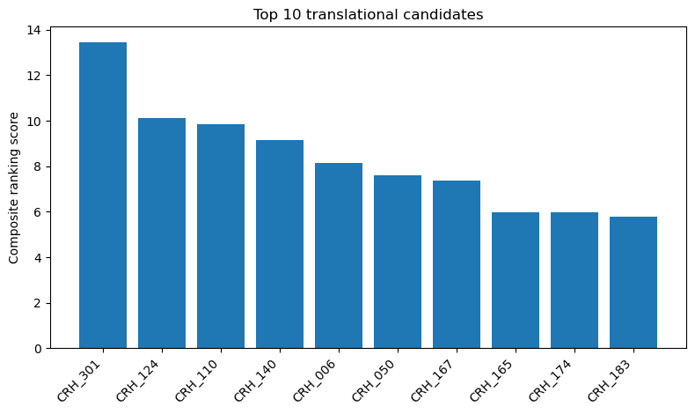
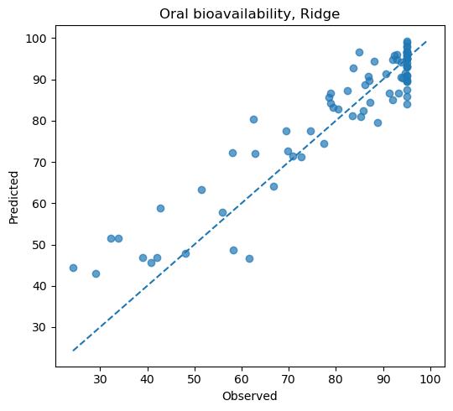
Human PK projection and portfolio ranking
Regression was informative, but not equally easy across endpoints; ranking still required scientific judgement.
Regression read-out
Best clearance model: Gradient Boosting
MAE 3.60 mL/min/kg
R² 0.390
Best oral F model: Ridge
MAE 5.22 percentage points
R² 0.864
Interpretation
Oral bioavailability was easier to learn because the synthetic portfolio encoded direct exposure drivers. Human clearance stayed harder, which is exactly the translational reality.
What the ranking added
The composite score integrated coverage, oral F, safety margin, half-life, dose burden, DDI burden, and intrinsic clearance. That made the final selection more robust than simply choosing the most potent or most exposed compound.
Notes:
[Sources] - User-provided executed notebook: /mnt/data/principal_scientist_dmpk_oncology_proof_of_concept_executed-2.ipynb - Derived plot assets: cell14_out0.png, cell14_out1.png, cell19_out0.png extracted from notebook outputs - Regression metrics and ranking logic reproduced from notebook outputs and manuscript text.

Slide 7
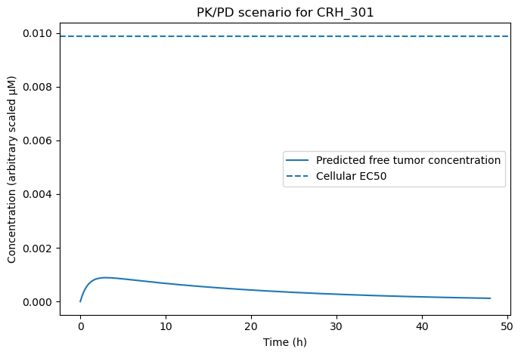
Top candidate deep dive: CRH_301
The best-ranked compound still needed a mechanistic challenge test before it could be considered truly de-risked.
CRH_301 | DNA damage response
Why it rose to the top
Projected human CL 6.075 mL/min/kg and half-life 54.758 h
Oral bioavailability 95.0% with predicted effective dose 74.949 mg
Coverage ratio 6.556 with manageable DDI burden score 0.1
Safety margin 16.917 and attractive overall multi-objective rank score
Stress test from the PK/PD scenario
The simplified tumor free-concentration profile stayed below the cellular EC50 line. In a real program, that would trigger schedule optimisation, tissue PK work, or a deeper PBPK/QSP pass before nomination.
Notes:
[Sources] - User-provided executed notebook: /mnt/data/principal_scientist_dmpk_oncology_proof_of_concept_executed-2.ipynb - Derived PK/PD plot asset: cell21_out0.png extracted from notebook outputs - Candidate metrics reproduced from the notebook top-candidate summary and top10 ranking output.

Slide 8
How to extend this into a real discovery program
The value is not in the synthetic data; it is in the decision architecture behind it.
Scientific depth
Quantitative toolkit
Decision mindset
Tight assay-to-model traceability for ADME, DDI, and safety margins
Explicit free-drug and tumor-exposure reasoning rather than total plasma PK alone
Mechanistic dose rationale instead of potency-led selection
PBPK for human translation and scenario analysis
PK/PD or QSP for target engagement and biomarker linkage
Interpretable ML for triage, not as a replacement for pharmacology
Translate multidimensional data into a few action-driving risks
Use clustering and ranking to focus teams on the right compounds
Challenge the winning compound before committing to nomination
Take-home: this demonstration shows how to connect DMPK science, translational modeling, and portfolio-level decision support to advance the best oncology assets toward the clinic.
Notes:
[Sources] - Conclusions are synthesis based on the user-provided executed notebook and manuscript created from that notebook: /mnt/data/principal_scientist_dmpk_oncology_proof_of_concept_executed-2.ipynb - Background rationale reflected in the notebook manuscript: Zhang et al., Cancer Chemotherapy and Pharmacology 2024, PMID 38994684; Saeheng et al., European Journal of Clinical Pharmacology 2018, PMID 29978293.

